Slide 1
Encryption using Transposition techniques
G SAITEJA -2010030055
K.ANIRUDH-2010030083
MD.ADNAN-2010030236
G.SAMANTH-2010030272

Slide 2

Introduction
In the cryptography system, a transposition cipher is a method of encryption by changing the position of plain text into different position. In this technique, the character or group of characters are shifted into different positions. That is the order of units is changed mathematically and gets the cipher text.

Slide 3
Abstract
This presentation contains the details of the project ‘Encryption using transportation Techniques’.
Text-encryption is a process in which the message send by the sender is encrypted so that only receiver can understand the message.
Encryption converts data into scrambled text.
The decoded text can be read by the receiver which maintains the security.

Slide 4
Transposition Techniques
Rail Fence Transposition
Columnar Transposition

Slide 5
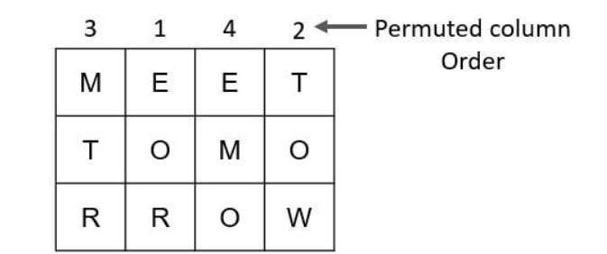

TECHNIQUES
Rail-Fence Technique Simple columnar transposition
Cipher Text: M E M T M R O E T E O O R W
Cipher Text: MTREOREMOTOW.

Slide 6

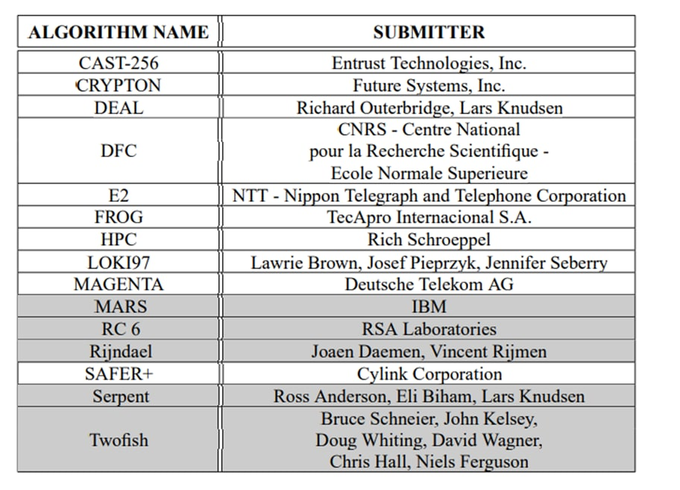
Literature review

Slide 7
Conclusion
In transposition technique, the identity of the characters remains unchanged, but their positions are changed to create the ciphertext. Transposition Cipher’s forms are:
Key-less transposition cipher .
keyed transposition cipher.

Slide 8


